Slide 1
AUTONOMOUS DRONE CONTROL
Elif Yağmur ERATALAY 201811028
Songül Meryem ÖZBİLEN 201711048
Ahmet Çetin TÜRKYENER 201711066
Advisor: Prof. Dr. Ahmet COŞAR

Slide 2
CONTENTS
Purpose
Main Features
Operation and Plan
How can we DO IT?
Environment and Tools Planned to Used
Comparison
Use Cases
Hardware Components

Slide 3
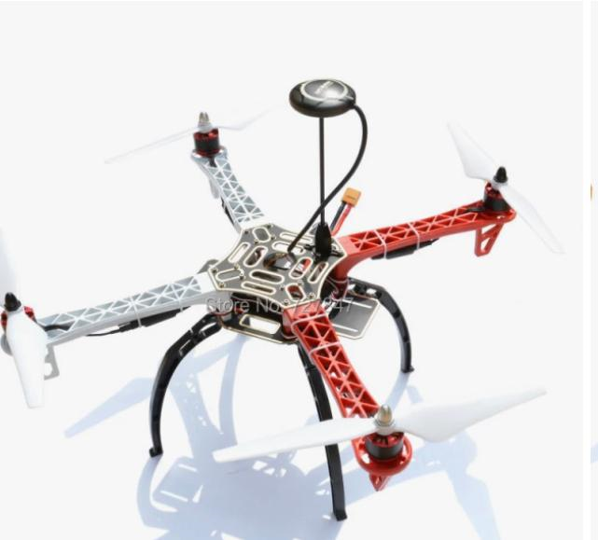
PURPOSE
Our aim in this project; to reveal a fully autonomous unmanned aerial vehicle that will enable it to successfully complete the test area by detecting the objects we have defined previously in our dataset, reducing the risk of accident.

Slide 4
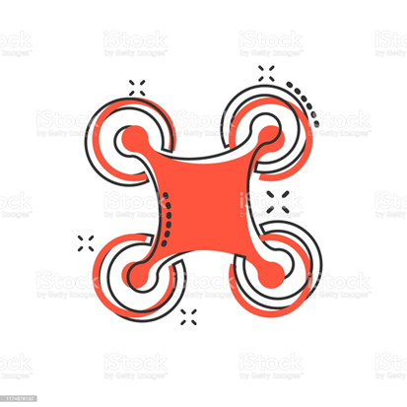
MAIN FEATURES
Identification of objects to the data set by image processing
The autopilot decides how to act according to these objects
The main features of the system are to operate artificial intelligence, autopilot and image processing software in an integrated manner and to ensure correct movements by providing correct command transfer to the drone flight elements.

Slide 5
OPERATION AND PLAN
The drone was started with the start button.
The drone started to rise.
The drone will start moving at the beginning of the track and in the direction of its direction.
When the drone encounters an object saved in its dataset, it will detect the object.
Distance of Detected Object will be calculated.
Based on the calculated distance, the drone will do the evasive maneuver.
It will come to the finish point after passing all the obstacles.
It will land at the return home.

Slide 6
How can we DO IT?
Creation Dataset
Image Processing with Artificial Intelligence
Autopilot

Slide 7
CREATION of DATASET
In order for the drone to recognize obstacles in our track, we will take multi-angle photos of the objects it will encounter and create our data set.

Slide 8
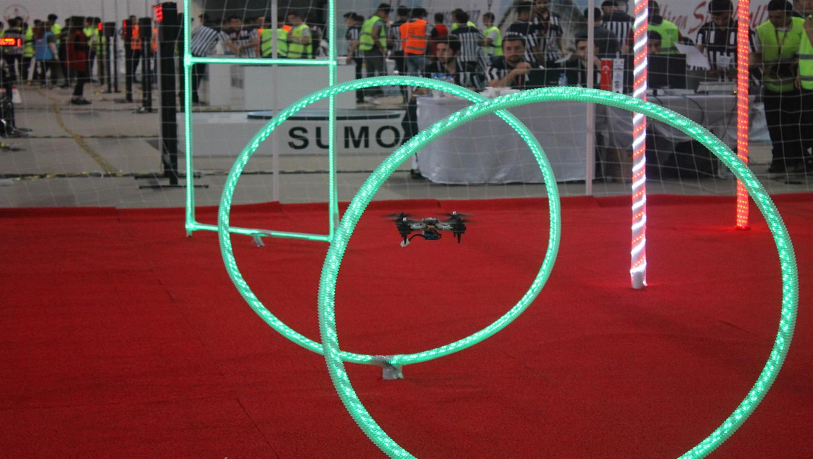

Slide 9
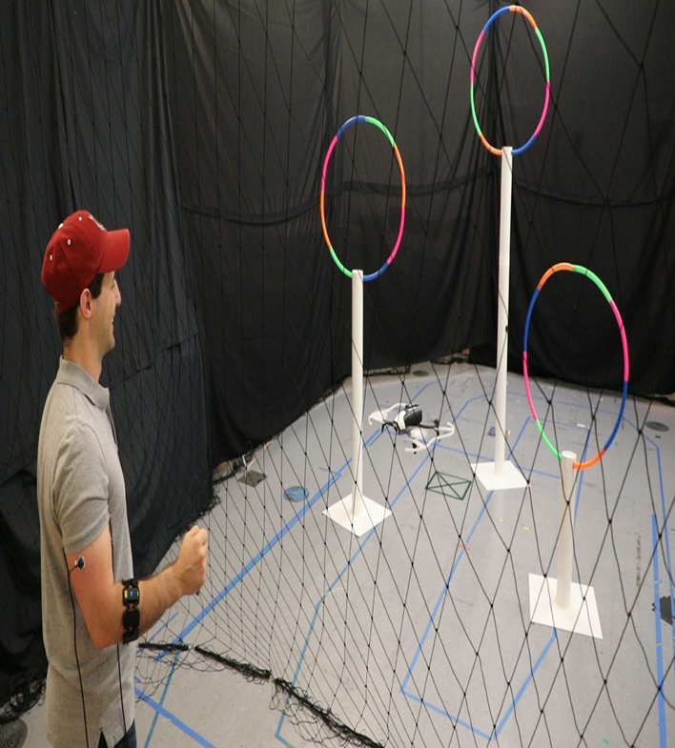
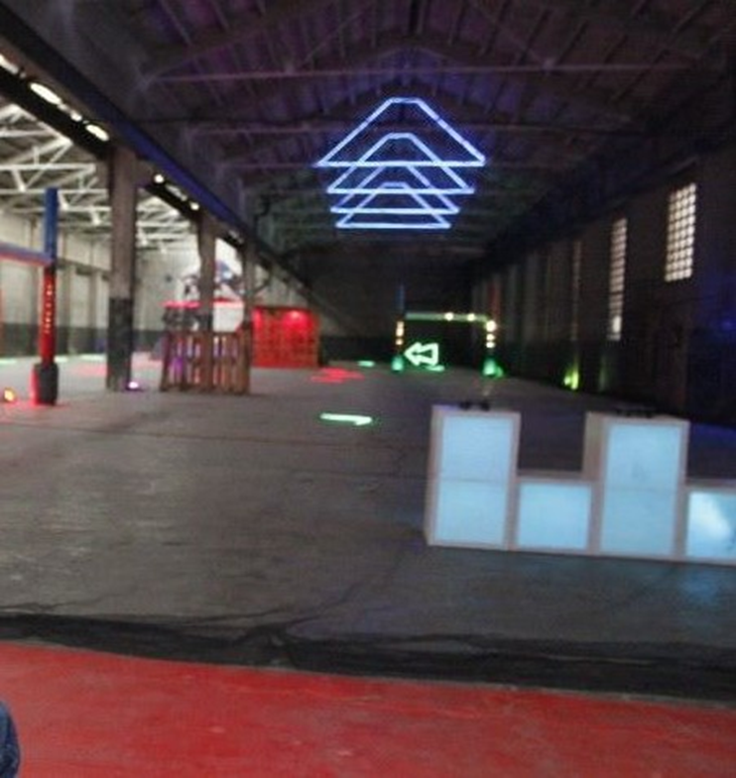

Slide 10
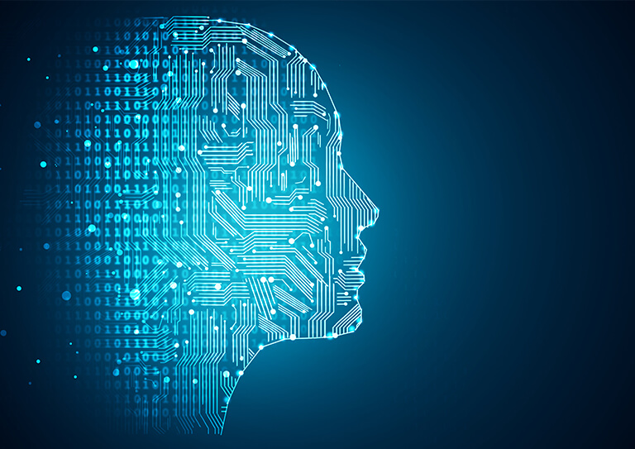
Image Processing with AI
Image processing and artificial intelligence are two of the most important elements at the center of the project. They will be used for detecting objects and transmitting location information.
We will use the YOLO algorithm for Image Processing.
YOLO is an algorithm for object detection using convolutional neural networks (CNN).

Slide 11
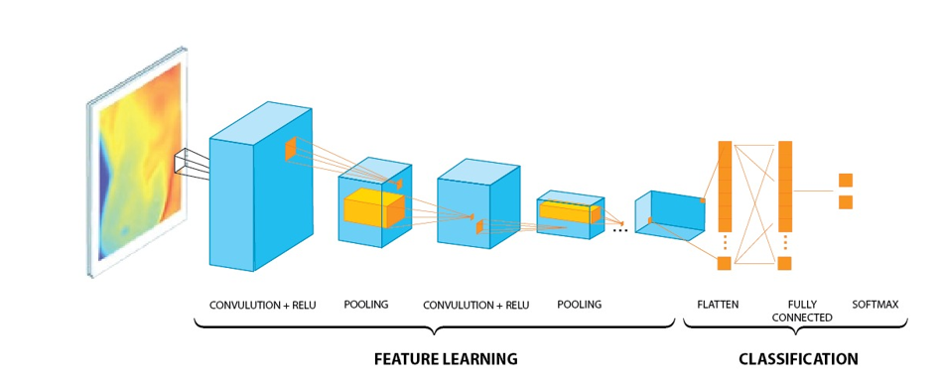
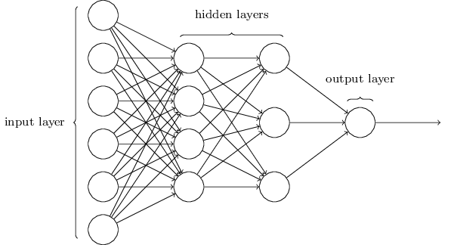
CNN

Slide 12
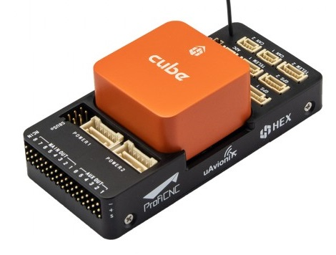
AUTOPILOT
It makes mathematical calculations by evaluating the information coming from image processing and decides its action according to the detected object.
We will use the open source Pixhawk Cube Orange autopilot for this drone.

Slide 13






Environment and Tools Planned to Used
We will use Python as the programming language.
Libraries to use;
-Tensorflow
-OpenCV
-Numpy
-Pandas
Environments:
-Pycharm
-Mission planner

Slide 14
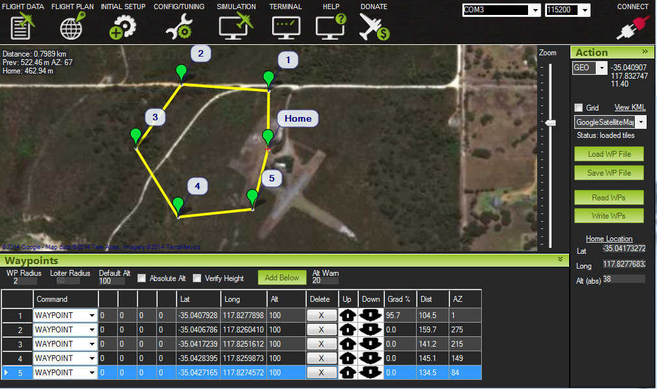
MISSION PLANNER

Slide 15
USE CASES
Profile Management
Settings Menu
Detected Object Pass
Usage Menu

Slide 16
HARDWARE COMPONENTS

Slide 17
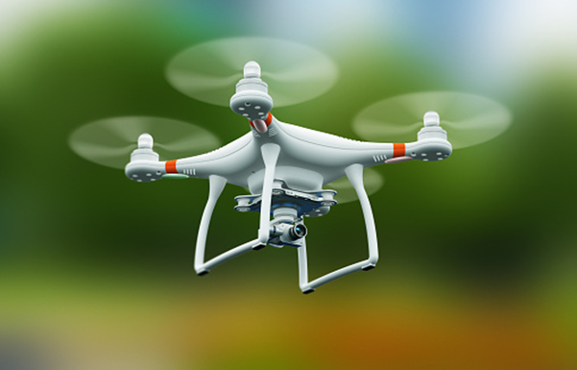
Quadcopter

Slide 18
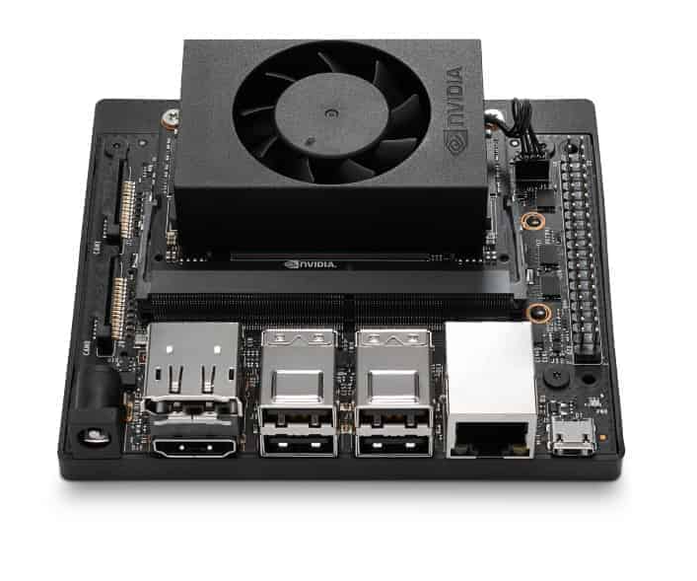
Jetson Xavier

Slide 19
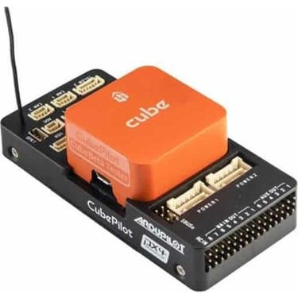
PIXHAWK

Slide 20
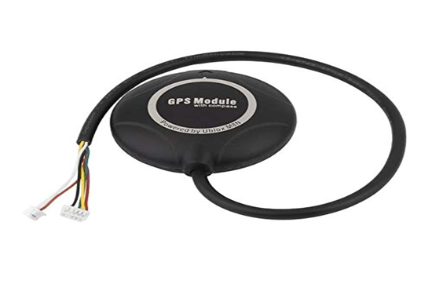
GPS

Slide 21
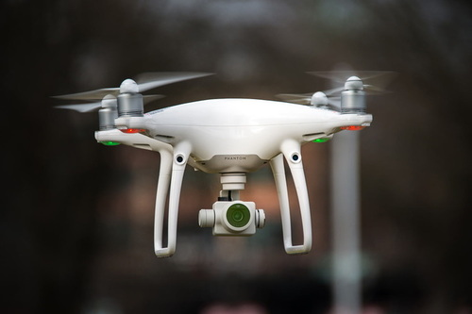
Camera

Slide 22
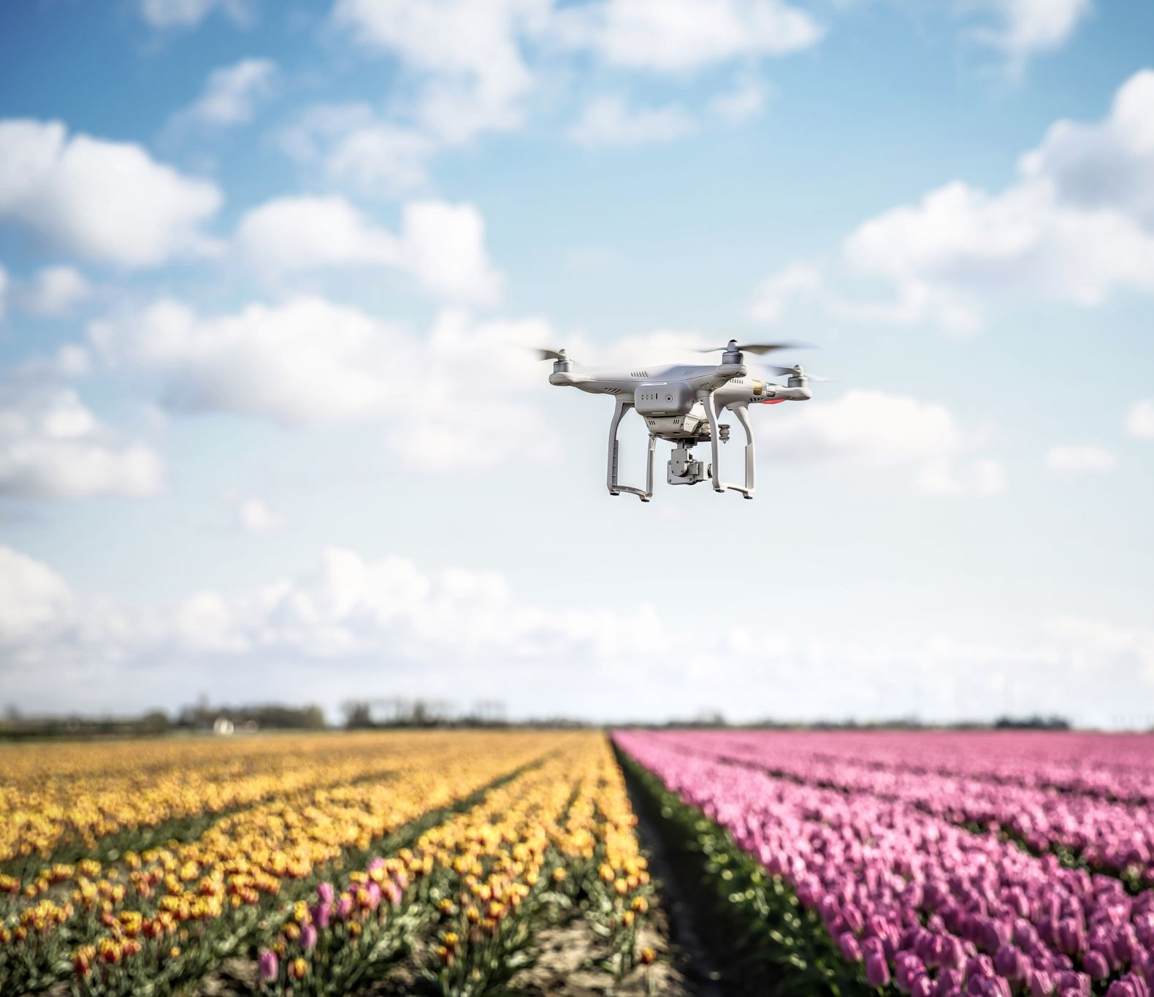
FUTURE PLANS
Creation of the dataset.
Testing of demo software
Application of successful demo software
Testing of the provided software in simulations. Completion of fixes based on tests
The design or supply of the drone whose strength and analysis are made according to the results obtained in the simulations.
Loading the successfully tested software onto the drone and conducting the first real-time tests.

